Slide 1
ASHRAE 90.1 Appendix G: Energy Modeling for Compliance with 2019 Oregon Commercial Energy Code

Slide 2
Acknowledgements

Slide 3
Agenda
ASHRAE Standard 90.1 Whole Building Performance-based Compliance Options
Overview of 90.1 Appendix G Performance Rating Method
Case Study
Q&A

Slide 4
ASHRAE Standard 90.1 Whole Building Performance-based Compliance Options

Slide 5
2019 Oregon Zero Energy Ready Commercial Code
Effective October 1, 2019
Based on ASHRAE Standard 90.1-2016 with state amendments
Includes two whole building performance options
90.1 Section 11 Energy Cost Budget Method (ECB)
Appendix G Performance Rating Method (PRM)

Slide 6
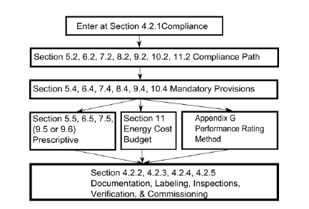
Standard 90.1 Compliance Options: Prescriptive Path
Documentation Requirements in
90.1 Sections 4-10

Slide 7
Standard 90.1 Compliance Options: Prescriptive Path
Section 5: Building Envelope
Mandatory + Prescriptive Requirements
Section 6: HVAC
Mandatory + Prescriptive Requirements
Section 7: Service Water Heating
Mandatory + Prescriptive Requirements
Section 8: Power
Mandatory + Prescriptive Requirements
Section 9: Lighting
Mandatory + Prescriptive Requirements
Section 10: Other Equipment
Mandatory + Prescriptive Requirements

Slide 8
Standard 90.1 Compliance Options: Whole Building Performance Path
Documentation Requirements in
90.1 Section 11.7 90.1 Section G1.3
DOE/PNNL 90.1 Whole Building Compliance Form

Slide 9
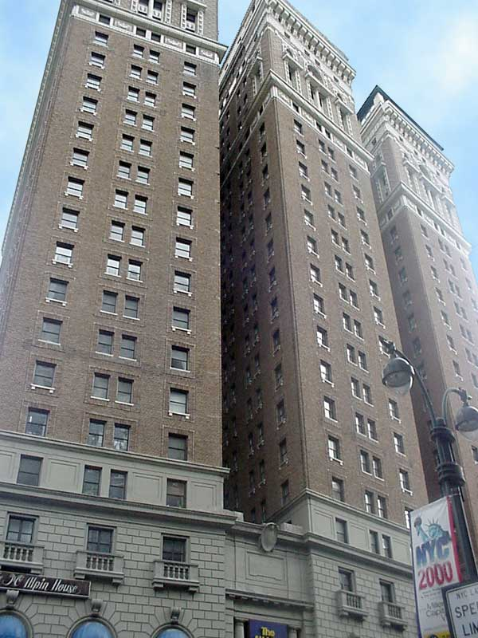
Whole Building Performance Path: General Concept
Model of the proposed design
Model of a virtual building used as a point of reference for evaluating proposed design
Developed following the rules of 90.1 Section 11 or Appendix G
Same simulation tool, weather file and utility rates

Slide 10
Key Similarities between 90.1 Section 11 and Appendix G
Modeling protocols that require use of whole building energy simulation
Allow projects to not meet some of the prescriptive requirements and make up for the associated energy penalty by exceeding minimum requirements in other areas

Slide 11
Key Difference between 90.1 Section 11 and Appendix G
Section 11 (Energy Cost Budget Method, ECB)
The budget design is a version of the proposed design minimally compliant with the current edition of 90.1
Proposed design complies if its annual energy cost does not exceed energy cost budget
Appendix G (Performance Rating Method, PRM)
the baseline design is based on proposed building type and location; most other characteristics reflect typical design compliant with 90.1 2004 and are independent of the proposed building
Proposed design complies if its annual energy cost is less than the baseline energy cost by a set margin

Slide 12
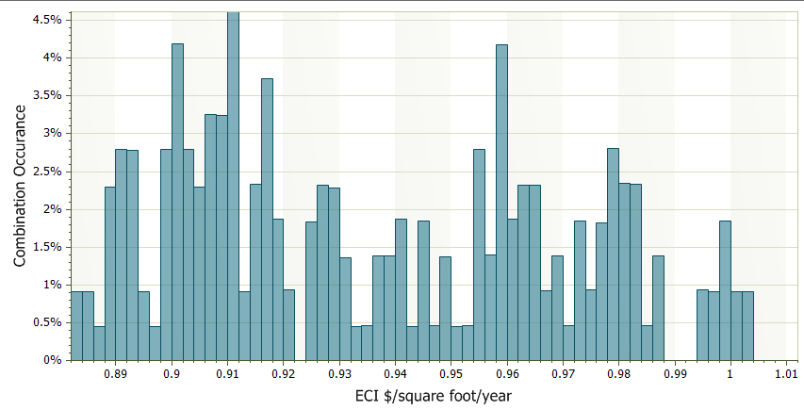
Appendix G Baseline: Independent of the Proposed Design
90.1 prescriptive compliance options and (to a lesser degree) Section 11 allows variation in energy use
14% variation in annual energy cost for an office in Climate Zone 5A
Appendix G baseline sets compliance threshold
* From PNNL “Roadmap for the Future of Commercial Energy Codes”

Slide 13
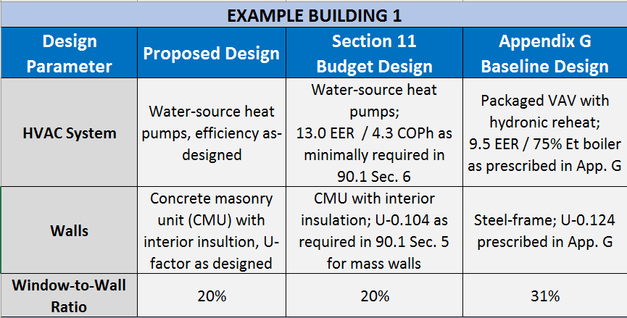
Appendix G vs. Section 11 40,000 SF Office Building in Portland, OR

Slide 14
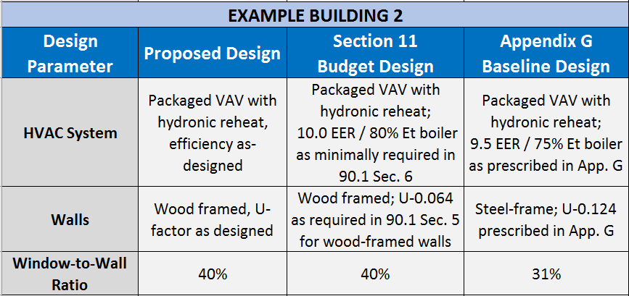
Appendix G vs. Section 11 40,000 SF Office Building in Portland

Slide 15
Relative Popularity of Whole Building Performance Approaches*

Slide 16
Examples of Above-Code Programs That Use 90.1-2016 Appendix G
EPA ENERGY STAR High-rise Multifamily Program
For project with the applicable energy codes based on 90.1-2013 or later, requires demonstrating the minimum 15% improvement over state code following 90.1-2016 Appendix G
LEED NC v4.1 EApc111: Alternative Performance Rating Method (1-18 points)
Demonstrate a minimum reduction of 5% for new construction or 3% for major renovations following 90.1-2016 Appendix G with LEED – specific Building Performance Factors.

Slide 17
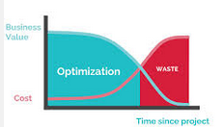
Why use Performance Path of Compliance?
To demonstrate compliance for projects that cannot use prescriptive path
To make up for systems not meeting prescriptive requirements of 90.1 by exceeding requirements for other systems.
To evaluate building performance in terms of energy cost
- Impact of design decisions on future utility bills
Economic analysis of various options.
To document above-code performance.

Slide 18
Common Trade-offs
Based on a national survey, majority of projects that use modeling to comply with the energy code trade off worse-than-code envelope for better than code lighting and HVAC

Slide 19
Overview of 90.1 Appendix G Performance Rating Method

Slide 20
Appendix G Performance Rating Method (PRM) History and Evolution
First appeared in 90.1-2004, to quantify performance of designs that exceed the requirements of the standard.
Became an alternative path of compliance with 90.1 starting from 90.1-2016 edition
May be used for evaluating performance of all proposed designs, including alterations and additions to existing buildings, except designs with no mechanical systems
The only method that can be used to both demonstrate compliance with code and above-code performance.

Slide 21
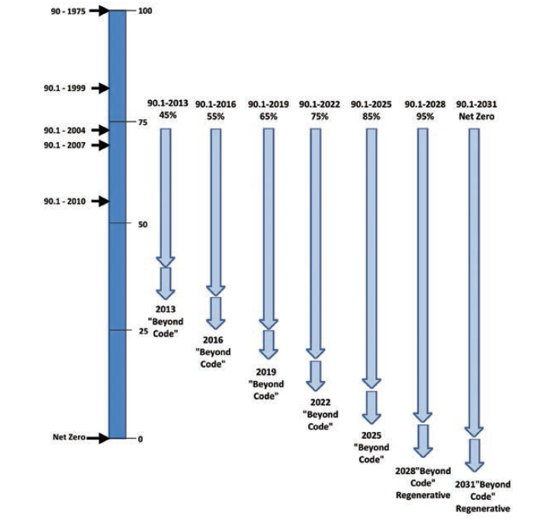
Appendix G Stable Baseline: General Concept
ASHRAE Journal, May 2013 “A Stable Whole Building Performance Method For Standard 90.1”

Slide 22
PRM Baseline is Included in the 90.1 Appendix G

Slide 23
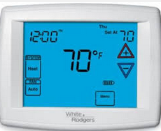
Trade-offs Limits
Mandatory Provisions (90.1 Sections 5.4, 6.4, 7.4, 8.4, 9.4, 10.4)
Operating Schedules
Except as specifically instructed, all building systems and equipment shall be modeled identically in the proposed design and baseline building design

Slide 24
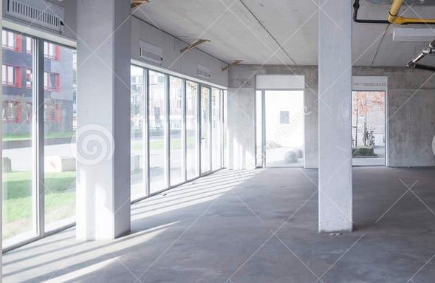
Special Cases
Retrofit Projects
Same baseline as for new construction projects
Proposed design modeled as it exists after renovation is completed
Core and Shell Projects
Same baseline as for new construction projects
When energy-related features have not yet been designed (e.g., a lighting system), those yet-to-be-designed features must be modeled in the proposed design to comply with but not exceed the applicable requirements of the current edition of 90.1

Slide 25
90.1 Appendix G Application Case Study

Slide 26
Modeling Process Overview
Review design to verify that mandatory provisions are met
Develop energy simulation of the building as designed and as prescribed in Appendix G to establish the annual energy cost of the proposed design.
Model the baseline design as prescribed in Appendix G
Separate baseline energy cost into regulated and un-regulated components to calculate Performance Cost Index Target (PCIt)
Calculate Performance Cost Index (PCI) as the ratio of proposed to baseline energy cost
Verify that PCI does not exceed PCIt

Slide 27
Case Study Description
Mixed use building in Portland
60% window to wall ratio;
24,000 sf office space on first floor
Hotel on floors 2-11 (150 guest rooms)
Lighting design of the office floor will be completed by future tenant

Slide 28
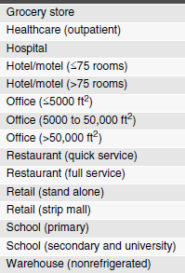
Baseline Envelope Requirements
Fenestration Area
Same floor area and shape as proposed design
Exposure-neutral
Prescribed U-values of opaque assemblies reflect 90.1-2004 requirements for roof insulated entirely above deck, steel-framed walls, slab-on-grade floors
Vertical fenestration area is prescribed for majority of building types

Slide 29
Proposed vs Baseline Envelope
Model Input Description | Proposed Design Model | Baseline Model
Climate Zone | 4C
Window to Wall Ratio, % of gross above-grade wall | 60% (as designed) | Hotel Floors: 34% Office Floors: 31%
Exterior Wall Type | Mass Walls (as designed) | Steel -framed
Exterior Wall U-value | As Designed | Hotel Floors: U-0.064 Office Floors: U-0.124
Roof Type | As Designed | Insulated entirely above deck
Roof U-value | As Designed | U-0.063
Window Properties | U-0.35 / SHGC 0.45 (As Designed) | U-0.57

Slide 30
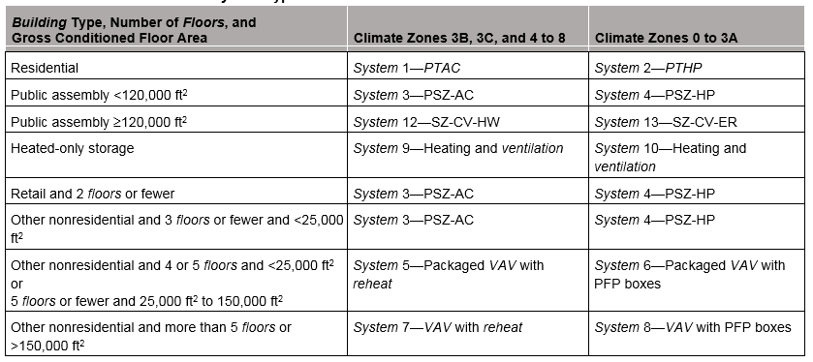
Baseline HVAC System Type
Depends on the building type and location
Does not depend on the specified HVAC

Slide 31
Proposed vs Baseline HVAC
 |  | Proposed Design | Baseline Design
Hotel Floors | HVAC System Type | VRF Heat Pump | System 1 - PTAC
 | Heating Efficiency | 3.68 COP | 75% efficient gas hot water boiler
 | Cooling Efficiency | 12.5 EER | 10.0 EER
Office Floor | HVAC System Type | VRF Heat Pump + gas-fired DOAS | Packaged rooftop unit, constant volume
 | Heating Efficiency | COP 3.68 VRF 80% efficient DOAS | 80% Ec furnace
 | Cooling Efficiency | 12.5 EER | 9.5 EER

Slide 32
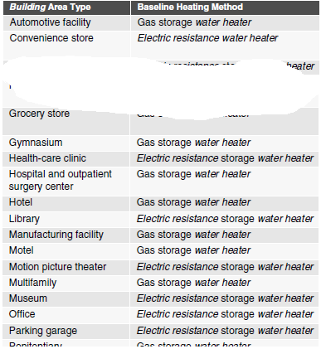
Baseline Service Water Heating
Central water heater
Heater type and fuel source prescribed based on building type
Baseline hot water load can be modeled higher than in the proposed design if proposed design includes measures that…
reduce the volume of hot water consumed (e.g. low flow fixtures)
reduce the required water temperature (e.g. use alternative sanitizing techniques)
increase the temperature of the entering makeup water (e.g. due to heat recovery)

Slide 33
Proposed vs Baseline Service Water Heating
 |  | Proposed Design | Baseline Design
Hotel Floors | System Type | As designed | Central gas storage water heater
 | System Efficiency | As designed | 80% efficient
 | Service water heating use | Reduced due to low flow faucets and showerheads | No low-flow fixtures
Office Floor | System Type | As designed | Central electric resistance water heater
 | System Efficiency | As designed | 80%
 | Service water heating use | Reduced due to low flow faucets | No low-flow fixtures

Slide 34
Baseline Lighting
Prescribed interior lighting power using space-by-space method
No daylighting controls
Occupancy sensors in limited number of space types, based on 90.1-2004 requirements
Prescribed tradeable exterior lighting wattage
Abstracts from 90.1 Table G3.7

Slide 35
Proposed vs Baseline Lighting
Building Area Type/Space Type | Proposed | Baseline
Hotel guest rooms | Wattages as designed, based on maximum rated fixture wattage Daylighting controls explicitly modeled Schedule adjustment for specified occupancy sensors based on fractions in Table G3.7 | 1.15 W/SF
Hotel Corridors |  | 0.5 W/SF
Hotel Stairs |  | 0.6 W/SF
Office Floor | 0.79 W/SF (Not designed, based on building area method in Table 9.5.1) | 1.0 W/SF based on Table G3.8 Building Area Method

Slide 36
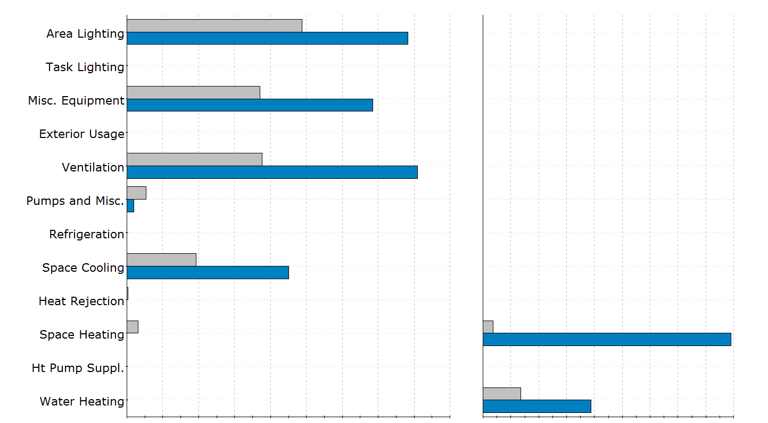
Baseline and Proposed Simulation Results
Baseline Design
Proposed Design
Electricity kWh
Gas MMBtu

Slide 37
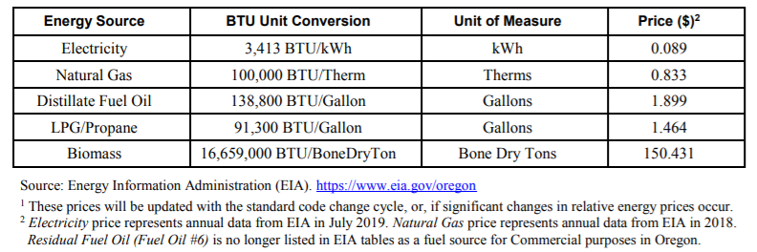
Oregon Statewide Average of Energy Prices*
Model results must be converted to energy cost using provided energy rates
*https://www.oregon.gov/bcd/codes-stand/Documents/energy-CPU-modeling-path.pdf

Slide 38
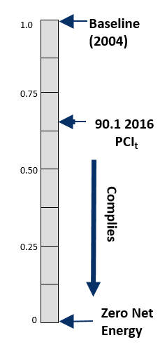
Compliance Calculations
$PCI =\frac{Proposed Building Energy Cost}{Baseline Building Energy Cost}$
PCI of 1.0 = baseline building
PCI of 0.0 = zero net energy
For compliance, PCI < PCI_{t}
$${PCI}_{t}=\frac{\left(BBUEC+\left(BPF·BBREC\right)\right)}{BBP}$$
$$BPF =Building Performance Factor$$
BBUEC = Baseline Building Unregulated Energy Cost
BBREC = Baseline Building Regulated Energy Cost
* From PNNL presentation at 2017 IBPSA Conference

Slide 39
Regulated vs Unregulated Energy Cost
Regulated Energy Cost (BBREC)
Energy used by systems and components with requirements prescribed in 90.1 Sections 5 through 10, such as interior and exterior lighting, HVAC, service hot water heating
Unregulated Energy Cost (BBUEC)
Energy used by building systems and components that is not regulated energy use, such as energy used by kitchen and laundry appliances, miscellaneous consumer electronics, etc.

Slide 40
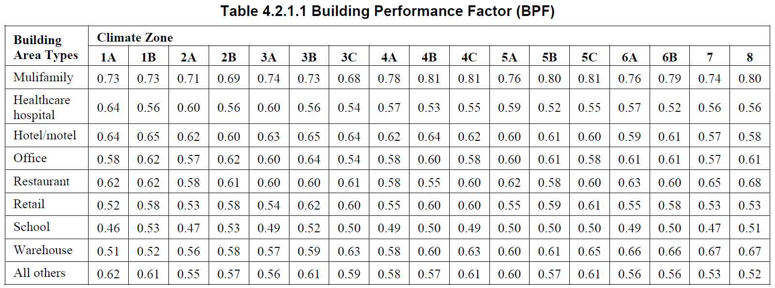
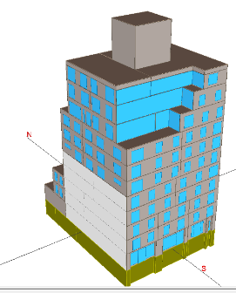
Building Performance Factors (BPF)
For mixed use buildings, the BPF is calculated as the area-weighted average of the building area types.
Mixed Use Hotel & Office in CZ 4C

Slide 41
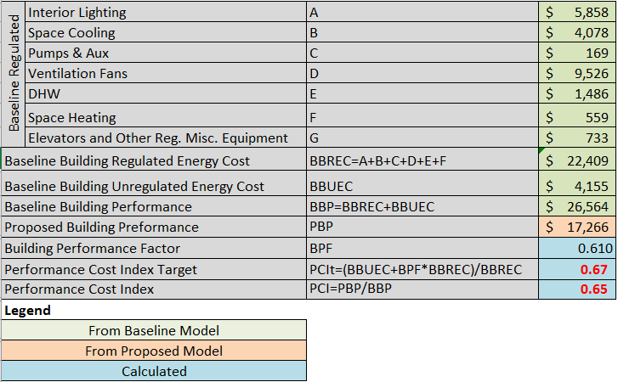
Case Study Compliance Calculations
PCI < PCIt
Project Meets Code!

Slide 42
Upcoming Training
May 20-21
Appendix G Modeling Workshop

Slide 43
Helpful Resources
ASHRAE 90.1 Portal – Redline versions to easily notice changes
ANSI/ASHRAE/IES Standard 90.1-2016 Performance Rating Method Reference Manual
BCD Website for training materials
https://www.oregon.gov/bcd/codes-stand/Pages/adopted-codes.aspx

Slide 44
QUESTIONS
Maria.karpman@karpmanconsulting.net

