Slide 1
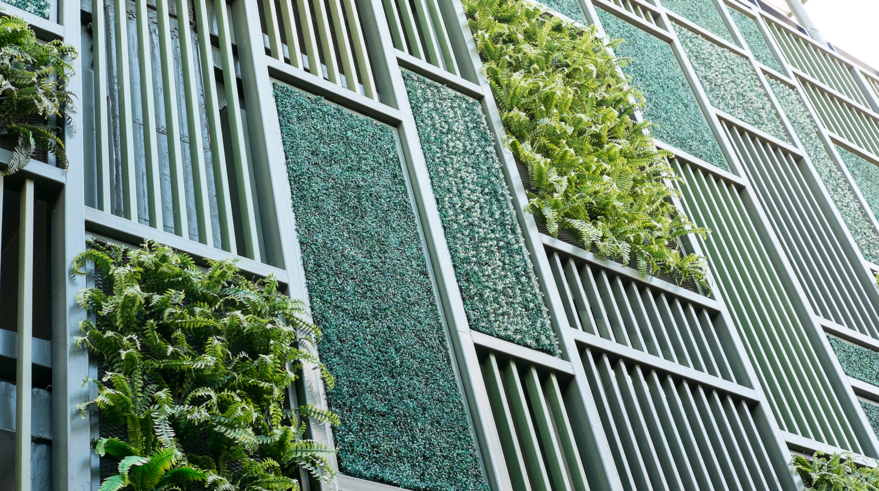

ENEGRY TRUST OF OREGON
NET ZERO FELLOWSHIP 2021
Reaching
Net Zero
In Affordable
Housing
By
Mark McKechnie, AIA
Oregon Architecture, Inc.

Slide 2
Agenda
Introduction
Research Strategies
Research Team
Research Results
Project Study in Brief
Research Conclusions & Lessons Learned
Research Tools
Research Goals

Slide 3
Introduction
Concept of Net-Zero
Net zero in energy growth is an effort to make energy production a zero-sum enterprise. The energy requirements of new users is off-set by the reduction in energy use from existing users and new supplemental sources.
Definition of The Term Net-Zero
Net Zero is exactly that – whatever additional energy is required by new construction is off-set by reductions from current users or provided by supplemental sources (i.e., on-site solar panels) so that additional output by power generating sources is not required.
About The Fellowship
The Energy Trust of Oregon annually awards a Fellowship to an entity involved in some way with the production or use of energy to study how or what can be done to reduce the rate of expansion on the power generation systems, hopefully reaching zero at some point in time.

Slide 4



Research Team
DAVID SOMMER
MARK MCKECHNIE, AIA, NCARB
NIRANJAN PATIL
Senior Project Manager at OAI
Architect, Principal at OAI
Design Project Manager,
Assoc .AIA, LEED Green Assoc. at OAI
Universal Technical Institute,
Phoenix, AZ
Former Director of Facility & Grounds
for Ashland Public Schools, OR.
University of Oregon, Bachelor of Architecture, 1972
University of Minnesota, Master of Architecture, 1978
Founding Principal
Oregon Architecture, Inc. 2008
Bachelor of Architecture
Chhatrapati Shivaji University, Kolhapur-IN.
Master of Science in Sustainable Design and
Master of Science in Construction Management Thomas Jefferson University, Philadelphia- PA.

Slide 5
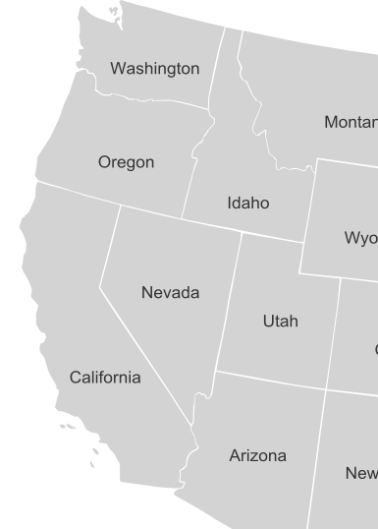

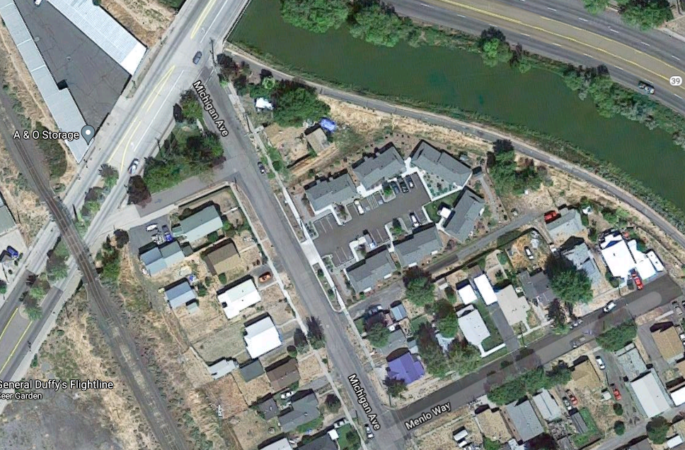
Project Studies In Brief
Project: Victory Commons and Trail’s View multifamily housing projects
for the Klamath Housing Authority.
Project Location: Klamath Falls, Oregon
Project Size: Duplexes, 1 Bedroom Units, 630 SF ea.
Duplexes, 2 Bedroom Units, 810 SF ea.

Slide 6





Research Tools
BEM is computer-based simulation practice software used to perform detailed analysis of energy usage within a building and its systems
Energy modeling evaluates the efficiency & performance of the building
Software/ tools : Sketchup & Sefaira by Trimble
Revit, AutoCAD & Insight 360 by Autodesk

Slide 7
Research Goals
Inform local Housing Authorities on a funding source to pay for additional energy efficient construction.
Provide information to builders in conventional markets that energy saving strategies can be financed in the conventional mortgage marketplace by utility savings.
Research to provide the Oregon Housing and Community Services Office with options to modify their standard rent/utility calculations to allow for more energy efficient construction.
Factor in strategies that recognize while utility costs increase with inflation, construction costs are fixed at the time of project construction.
Over time utility savings can provide more available funds for mortgage servicing.

Slide 8
Research Strategies
Energy Usage Data
Properties Timespan | *Victory Commons 1 BR Unit | *Victory Commons 2 BR Unit | *Trail’s View 1 BR Unit
Avg. Per Month | $52.65 | $90.05 | $78.91
Avg. Per year | $631.77 | $1080.61 | $946.90
**10 years projection | $6,917.71 | $11,503.90 | $10,368.30
**20 years projection | $15,350.35 | $25,527.00 | $23,007.18
**30 years projection | $26,774.00 | $44,524.30 | $40,129.00
**Note: Escalation rate for future electricity costs is at a 2% increase per year, based on historical data.
*Baseline units were originally constructed with some efficient energy strategies that went above the minimum Building Code energy requirements at the time of permitting.

Slide 9
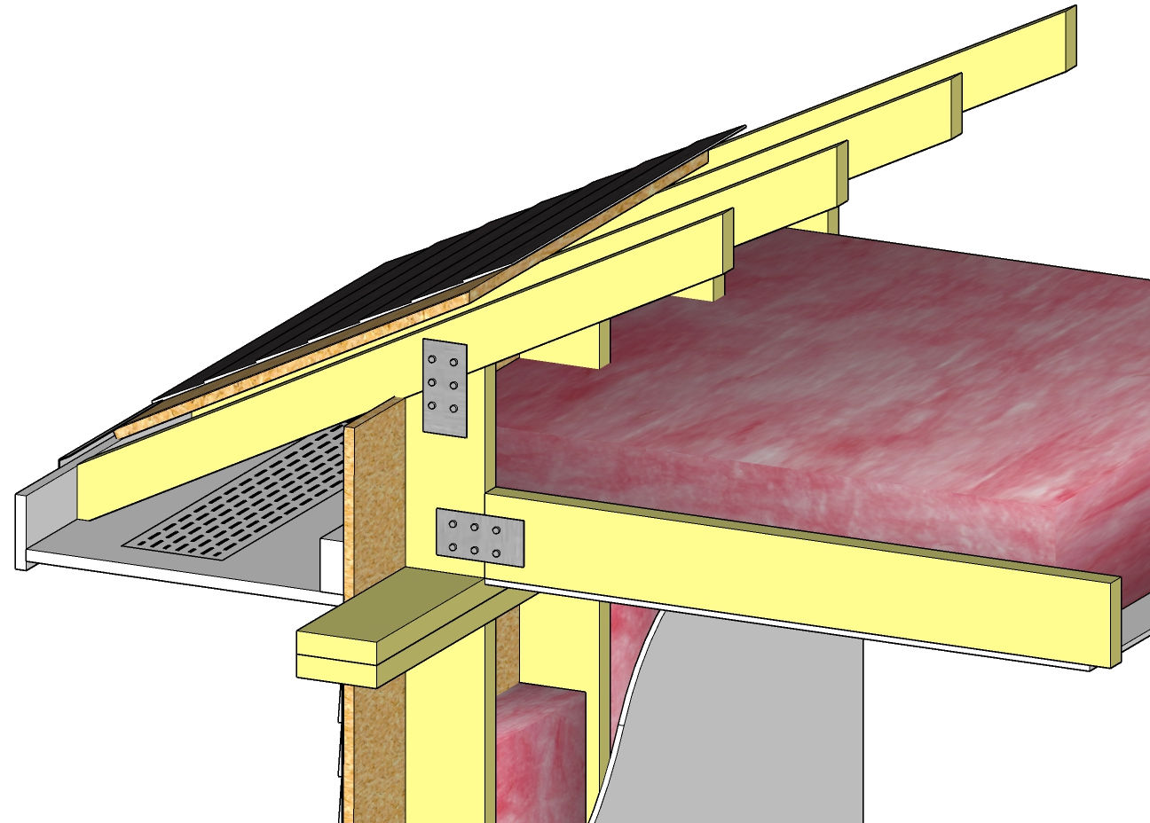
Raised-Heel / Energy Heel Truss
Efficient use of attic insulation, especially at the narrow part of the truss
Adequate attic ventilation, thus no mold issues, better control of air infiltration
More comfortable interior
Economical method of producing a more resilient building envelope
No special training required for installation
Roofing material
Heel truss
Fiber glass insulation
OSB
Sheathing
12”
Attic ventilation

Slide 10
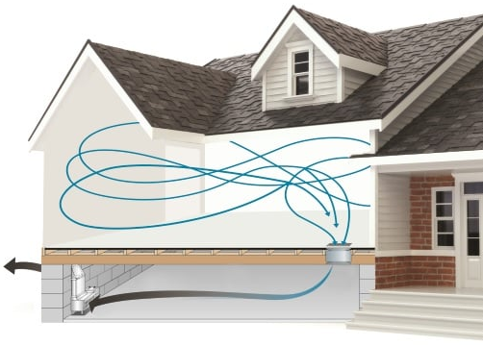
Mechanically Vented Crawl Space
Required less energy to keep the living space at comfortable temperature, hence improves indoor air quality
Helps to remove any moisture saturated with space and walls
Reduces mold & wood decay on floor joists

Slide 11
Project Strategies
Design strategies to reduce / eliminate the load on mechanical systems.
Exceptional Thermal Performance, Healthier air quality, faster construction with less labor, design flexibility.
Building
Orientation
Daylighting
Trombe
Wall
Passive
Design
SIP’s Panel
Heat exchange concept. Works in mild climates as well as extreme cold, can be used for cooling or heating the building, aesthetically attractive
More energy efficient design, good for daylighting, summer-winter winds, sun & solar tempering.
Understanding the lighting needed & heat gain for interior spaces, minimize the use of artificial lighting during day time.

Slide 12
Project Strategies
Highly insulated, low U-value, low-E,
appropriate sizes, optimized window to floor Area (WFA), high SHGC
Strategic lighting, LED lighting, Energy star rated appliances to reduce electricity consumption.
Weather
Seal
Solar Panel
Net
Zero
Efficient Door &
Windows
Energy Efficient
Appliances
Airtight building envelope, cost effective, reduce the load on HVAC.
Clean & Green energy source, low maintenance, diverse application,
generates electricity to support building needs or demands

Slide 13
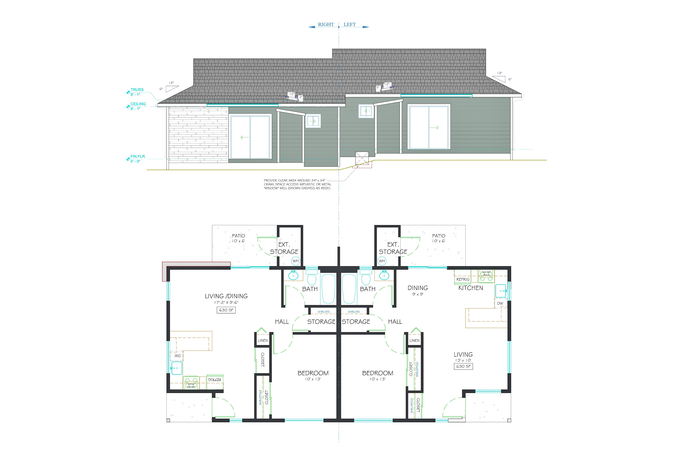
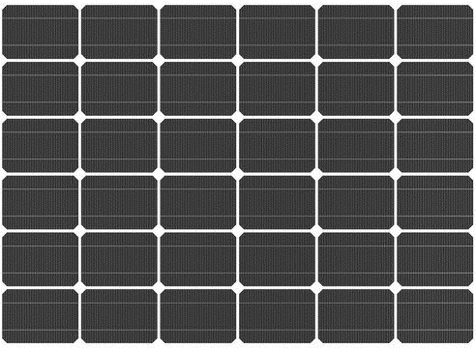
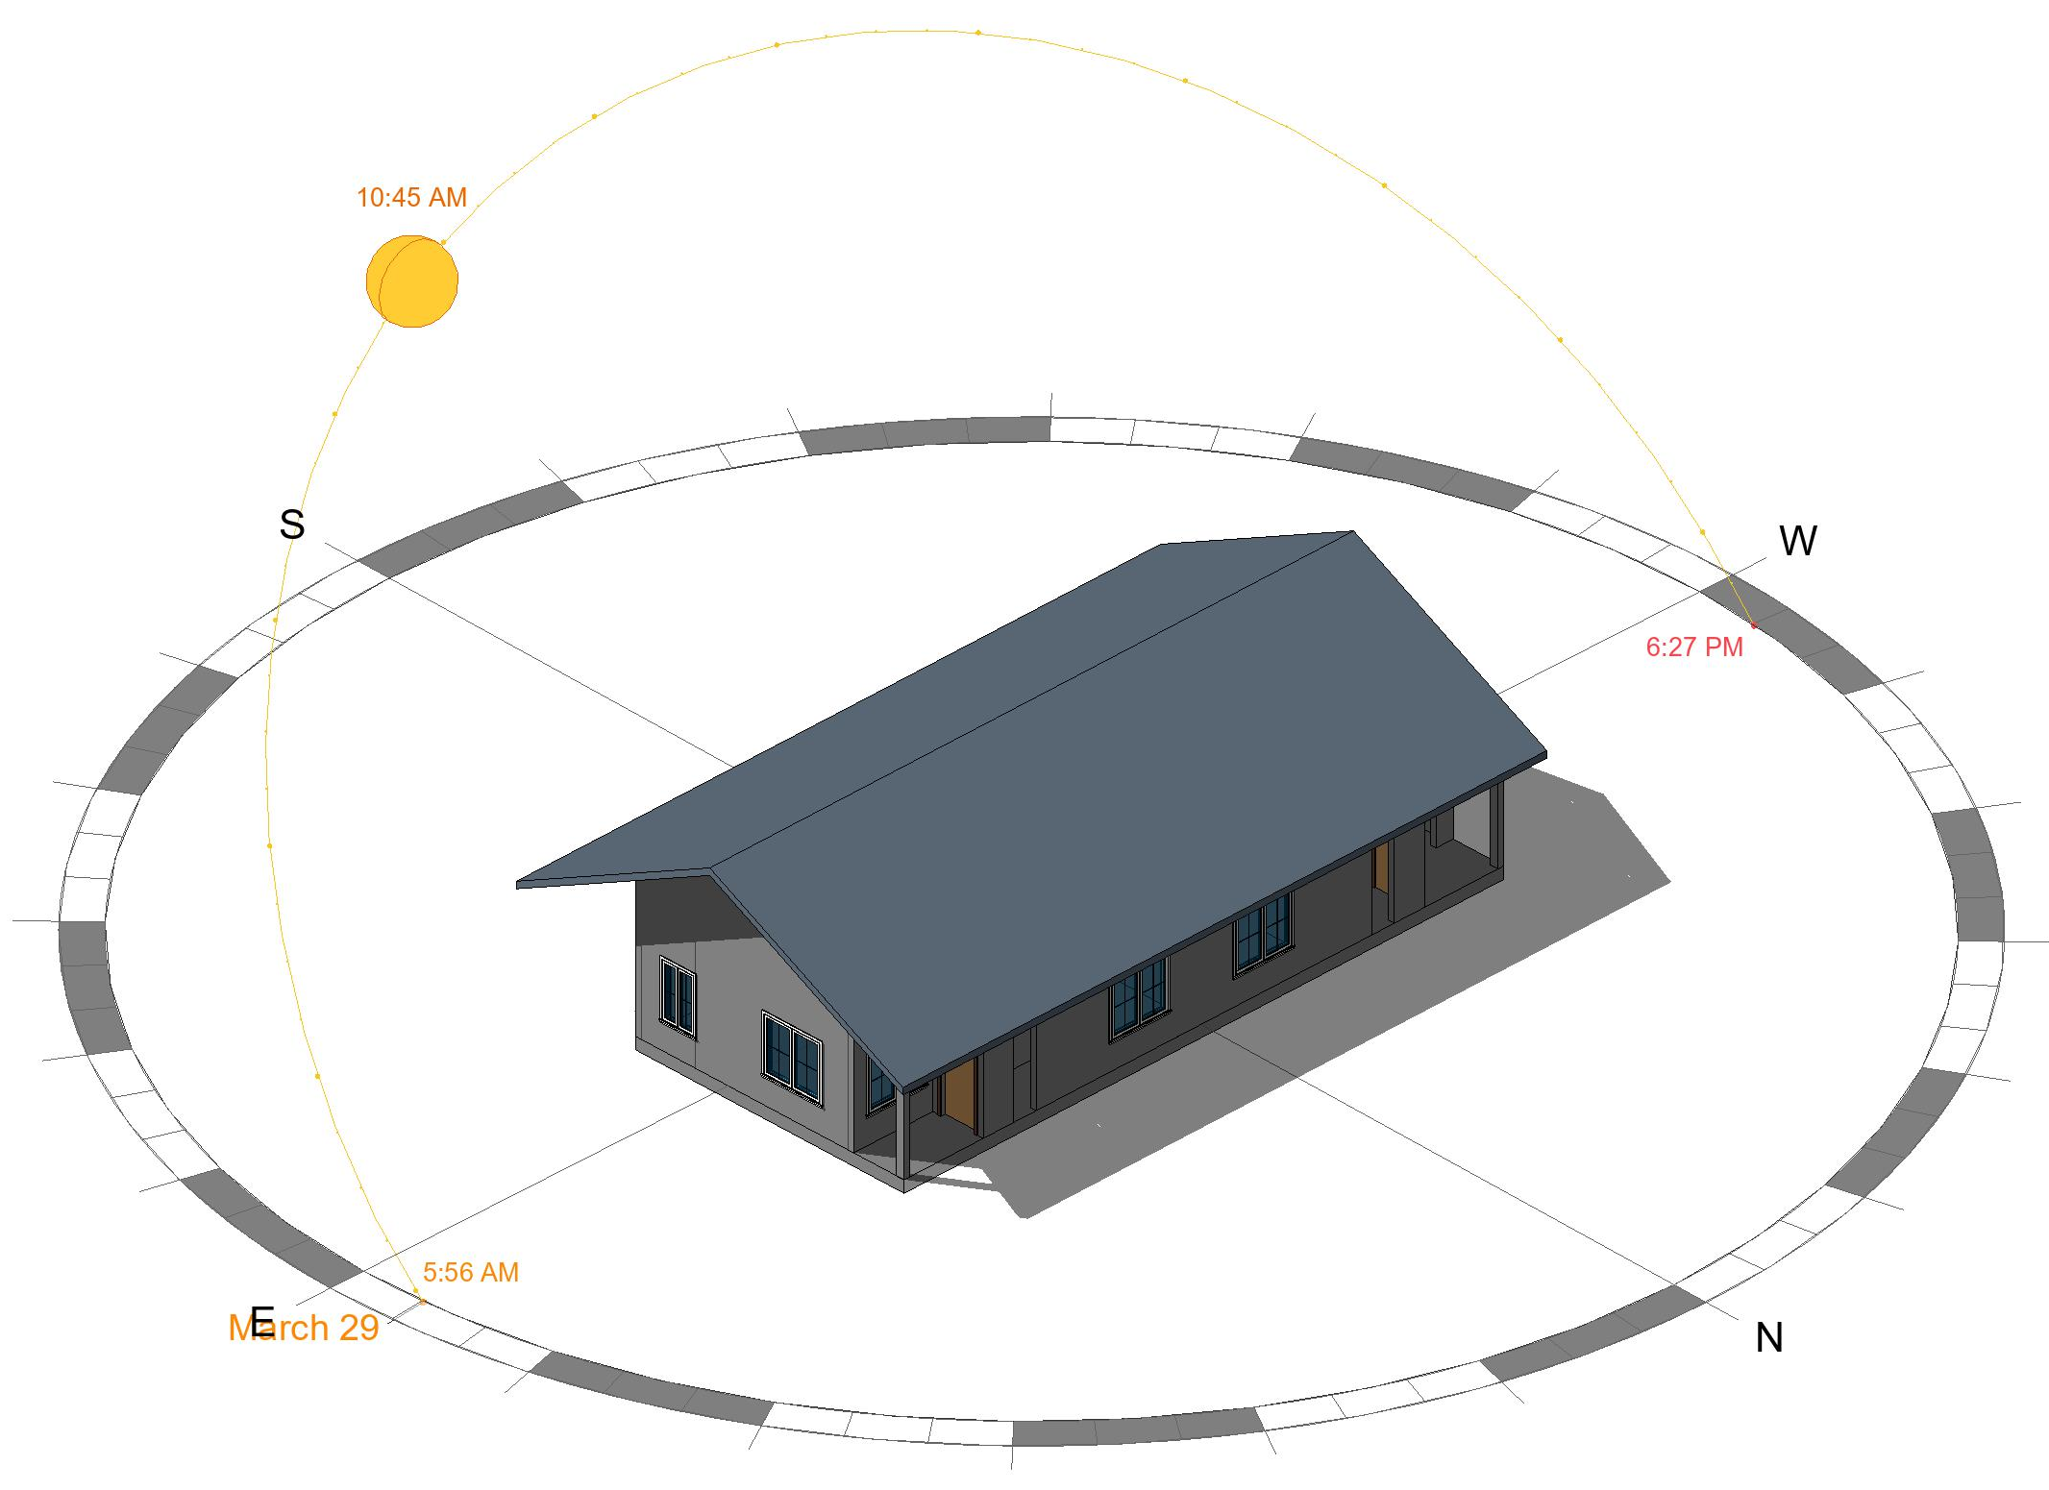
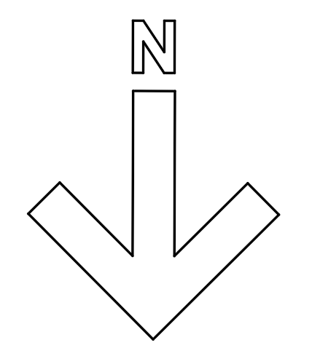
Strategy 1: Building
Orientation
After
Before
SOUTH ELEVATION
Not To Scale
PLAN
Not To Scale

Slide 14
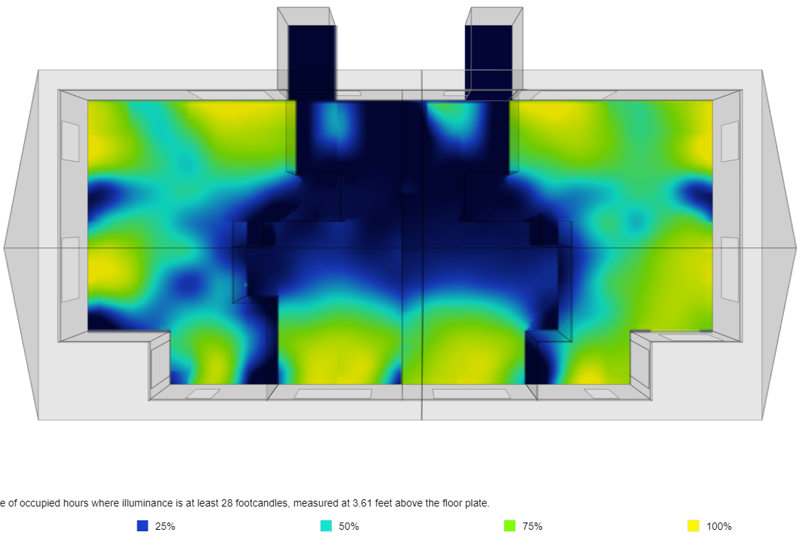
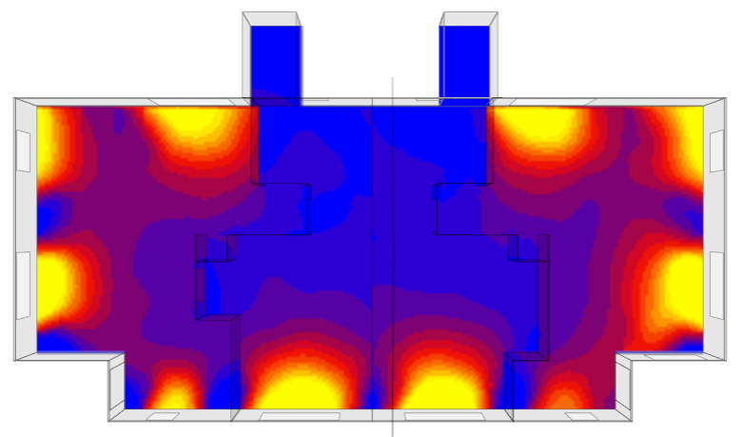
Strategy 2: Daylighting
Analysis
Daylight
Reduce the need for artificial lighting
Reduce electricity costs
Can reduce HVAC costs as well
Enhanced indoor air quality
Enhanced thermal comfort
Improved mental & physical health
Radiant Temperature

Slide 15
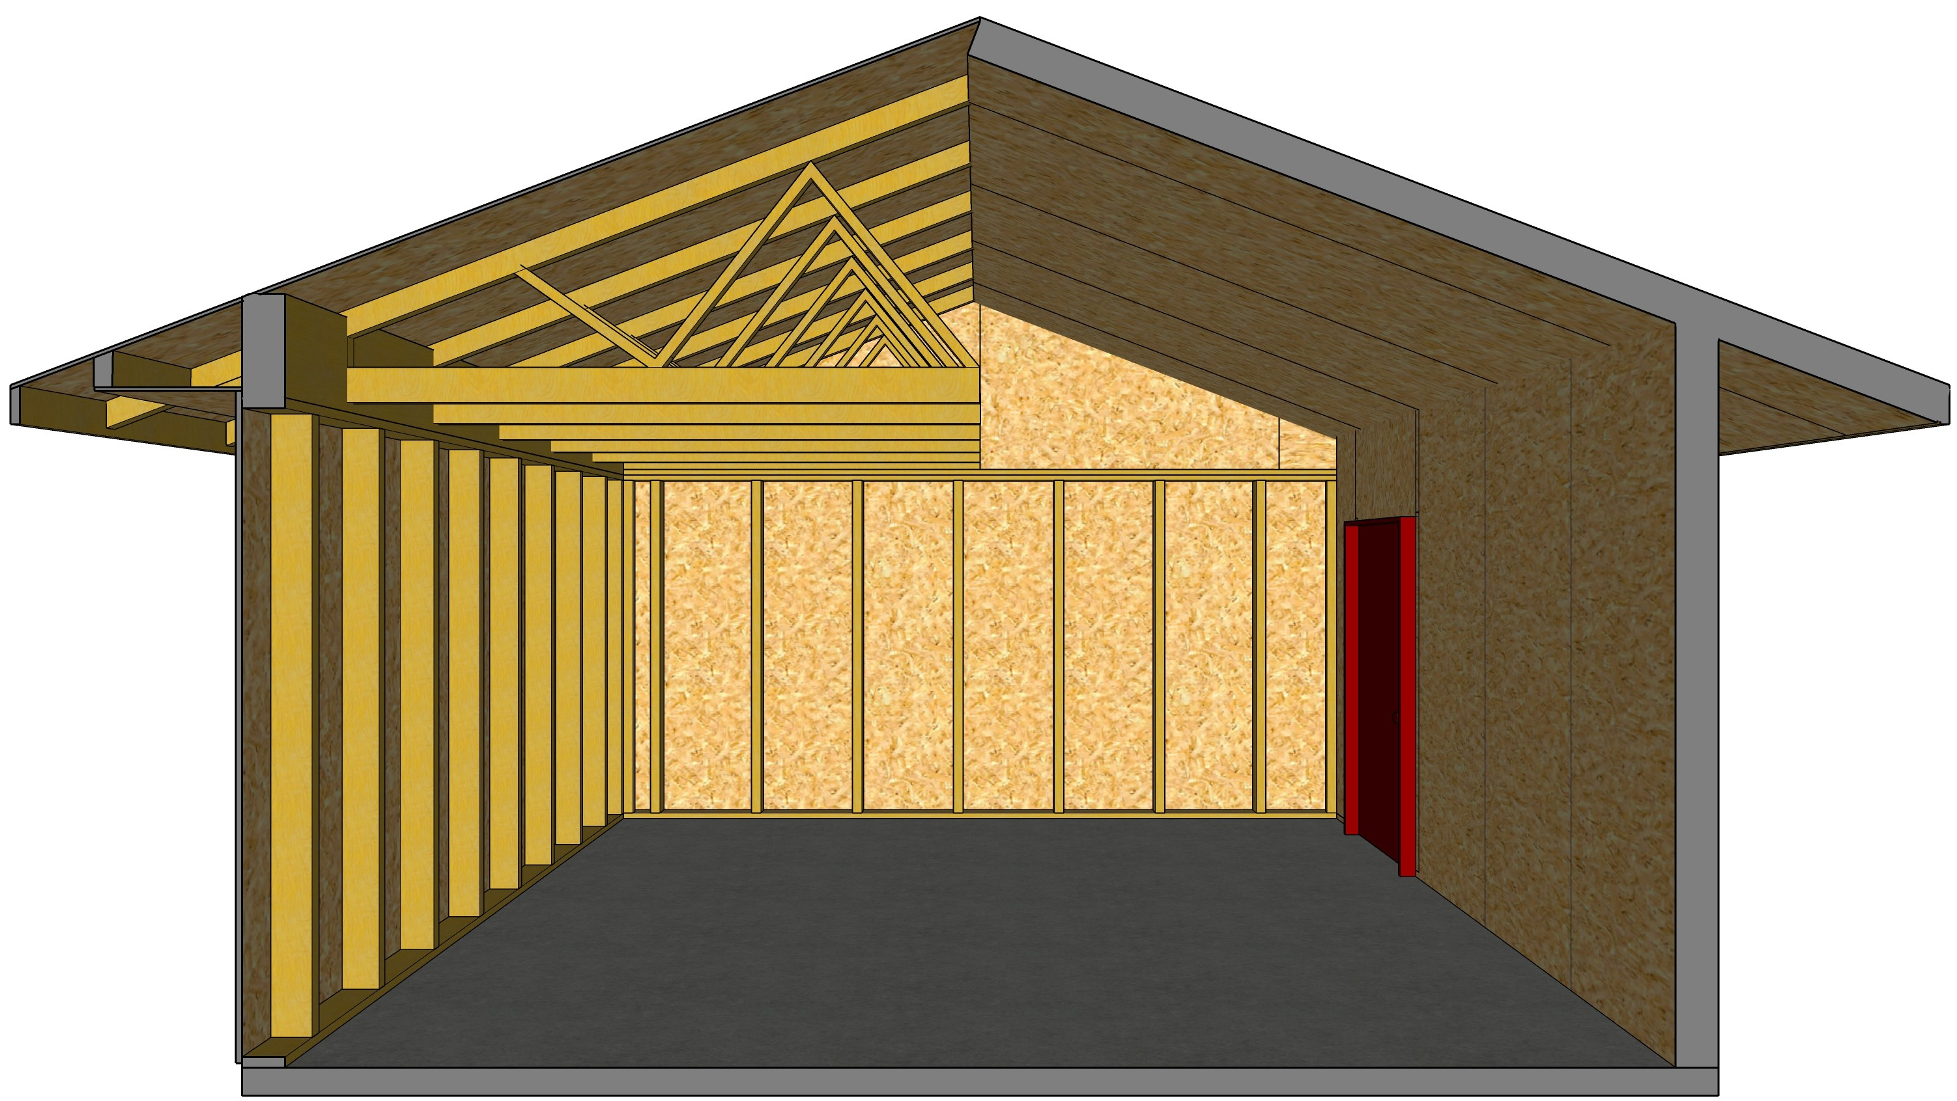
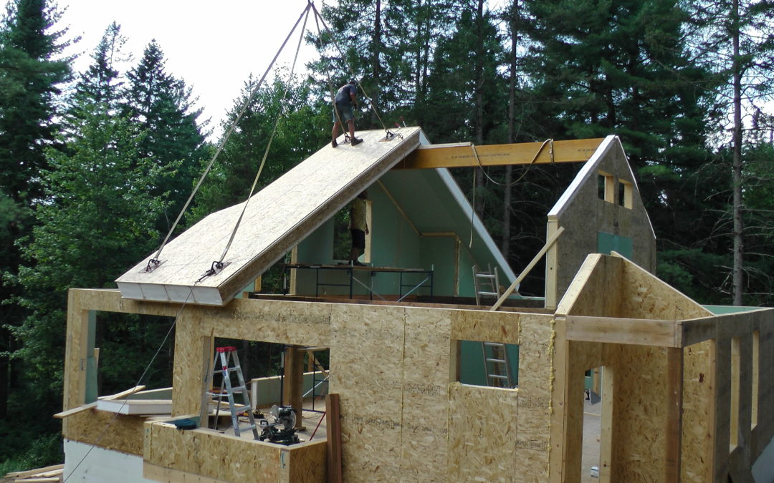
Strategy 3: SIP’s Panels
SIPs Framing VS Stick Framing
SIPS FRAMING
Snap Lines | 1 Day
Plates | 1 Day
Frame | 3 Days
Plumb & Line | 1 Day
Set Beams | 1 Day
Roof Panels | 1 Day
Total | 8 Days
STICK FRAMING
Snap Lines | 1 Day
Plates | 1 Day
Frame | 4 Days
Plumb & Line | 2 Day
Set Beams | 2 Day
Roof Panels | 2 Day
Total | 12 Days
Exceptional thermal performance
Healthier air quality
Faster construction with less labor
Design flexibility
Note: Based on actual production builder’s 2,500 SF single homes by Primer Building Systems
@Petra Building Soulution

Slide 16
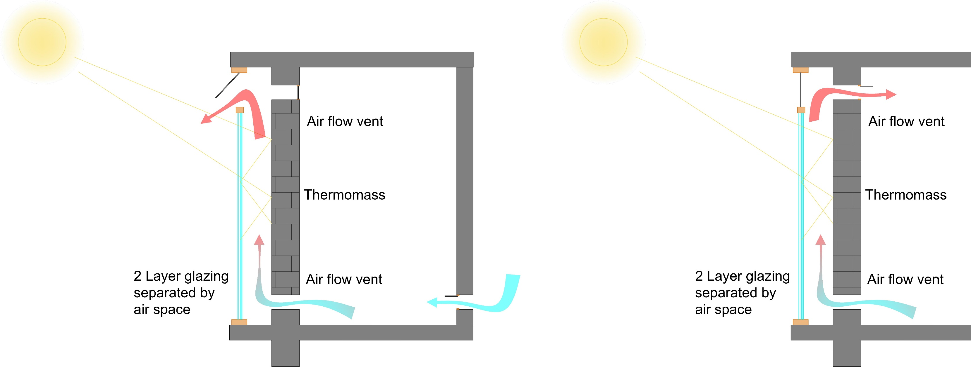
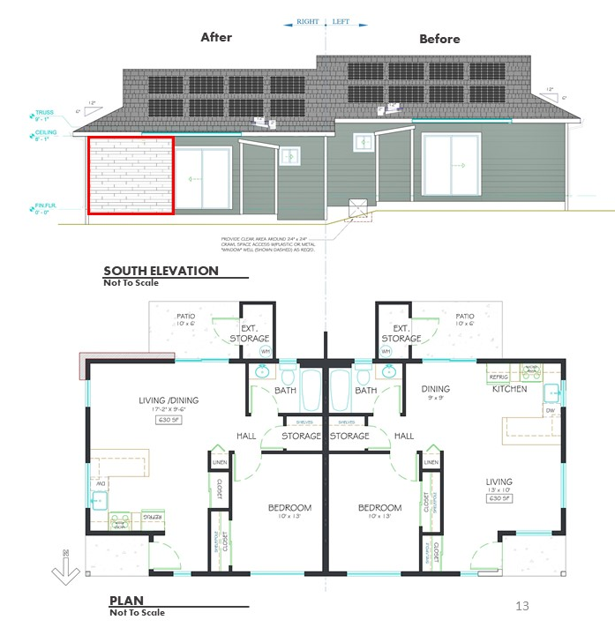
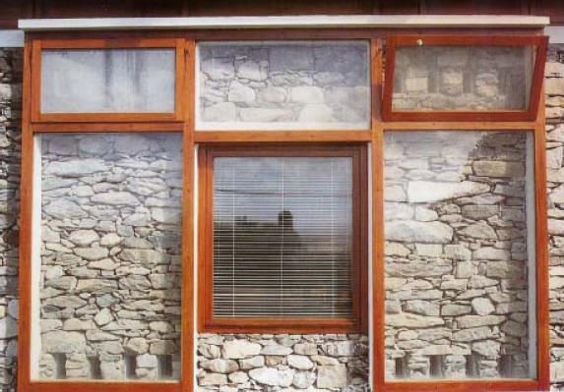
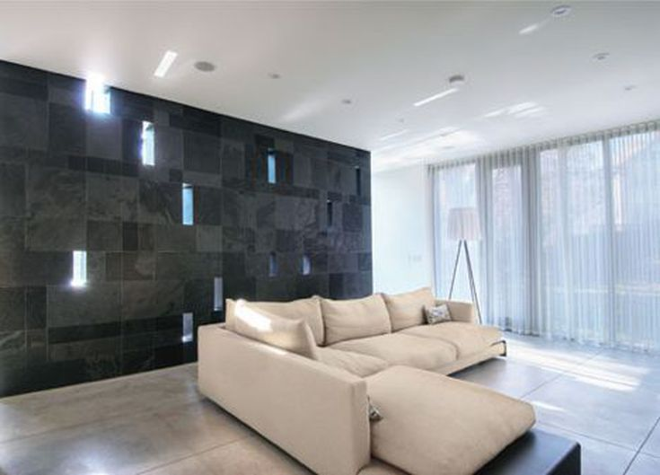
Strategy 4: Trombe
Wall
Most flexible solar option
Can work in mild climates as well as extreme cold
Provides comfortable heat
Passive design – no moving parts
Reduces glare on furniture compared to direct gain design
Significantly reduces heating bills
Simple construction
Aesthetically pleasing
SUMMER
WINTER
Image credit: Egon Vettorazzi, & Pinterest
Image credit: Paul Raff Studio

Slide 17
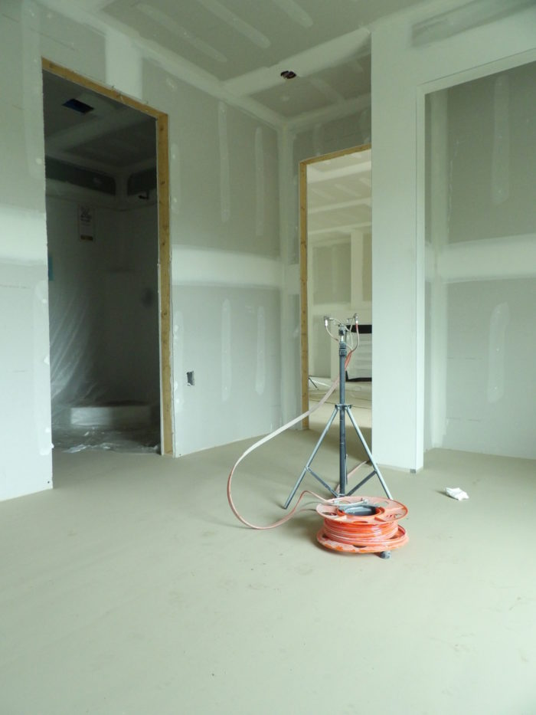
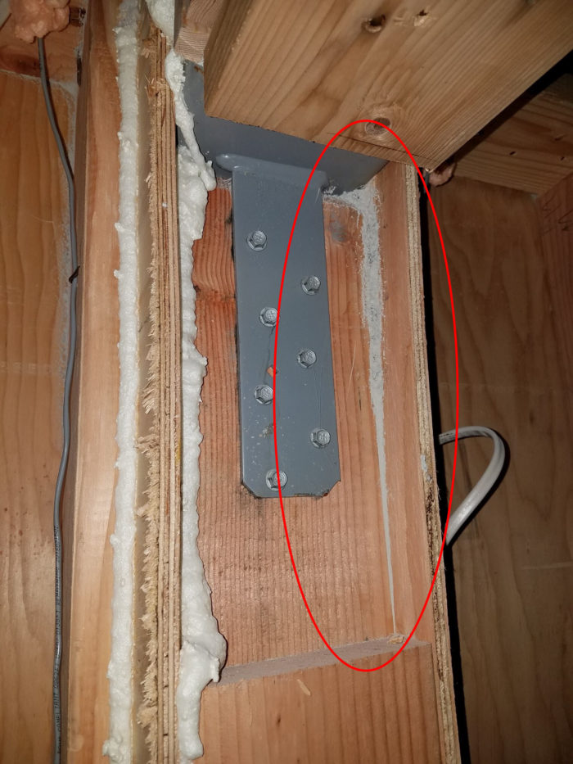
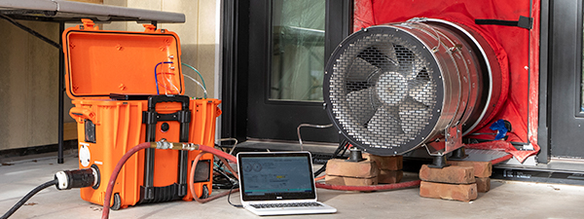
Strategy 5: Weather Seal
Exceptional airtightness in Building envelope
Healthier air quality
Seals all crack and gaps
Eliminates leaks that degrade HVAC performance
Increased design flexibility
Faster, more reliable and potentially cheaper than air-seal by hand
Requires positive ventilation
STEP 3
© 2021 Aeroseal,LLC.
STEP 1
STEP 2
STEP 4
Prep & Setup:
AeroBarrier system & nozzles are setup throughout the house. Designed openings that will not be sealed are protected. (e.g. Windows)
Pressurize & Apply:
The area is pressured with a modified blower door & fan and rest process is controlled by computer.
Seal & Monitor:
A final blower door test is run & a report is created, documenting pre & post leakages.
Cleaning:
After the seal is completed, all equipment & prep work is removed. Work can resume in 30 min.

Slide 18

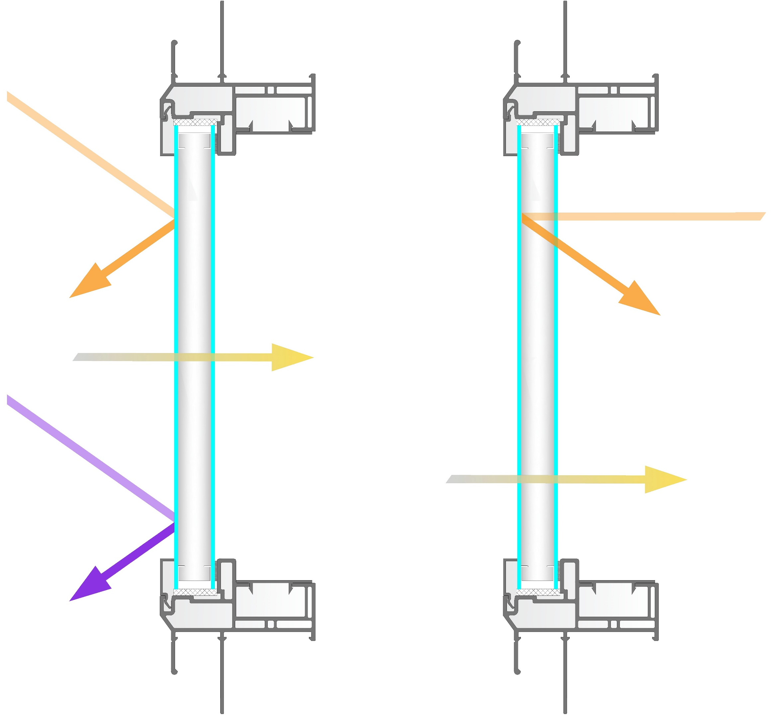

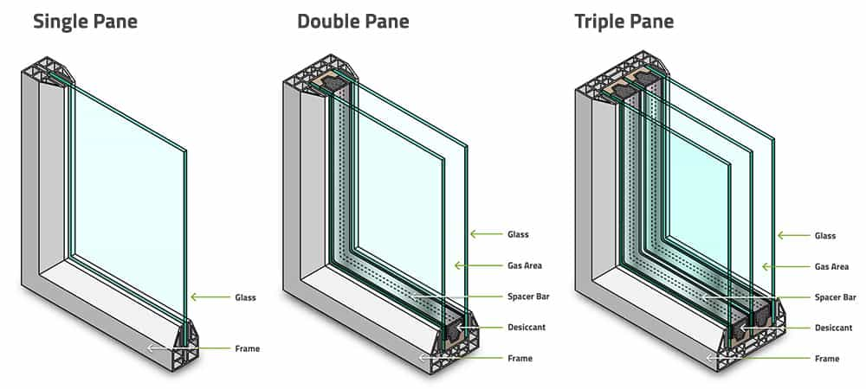
Strategy 6: Efficient Door & Windows
Better insulation
Eco- friendly
Lower HVAC costs
Less damage to interior
Sound proof
Reduced maintenance
Solar Heat
Warmth
Visible light
UV light
Visible light
SUMMER
WINTER
Low-E Glass reduces heat gain
From the sun in the summer,
Keeping you home cooler.
In the winter, Low-E glass lets the warm solar rays in while blocking the heat in your home from getting it out.
© 2021 WCMA NET Window & Door

Slide 19
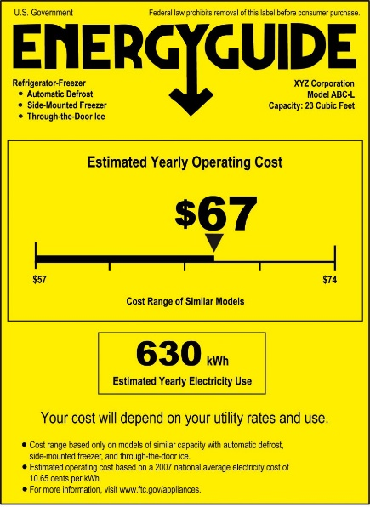

Strategy 7: Efficient Appliances
Reduces energy consumption
Reduced carbon footprint & greenhouse gas emissions
Significantly reduce utility bills
Earn a great return on your investment as they last longer
Enhanced quality of life
Residential Building Energy Consumption by End Users
Source: Environmental & Energy Study Institute
Source: Environmental & Energy Study Institute

Slide 20
Building Analysis
Proposed
Baseline
Walls : R-41 SIPs
Windows: U-0.18
Roof: R-41
Walls : R-21
Windows: U-0.35
Roof: R-38

Slide 21
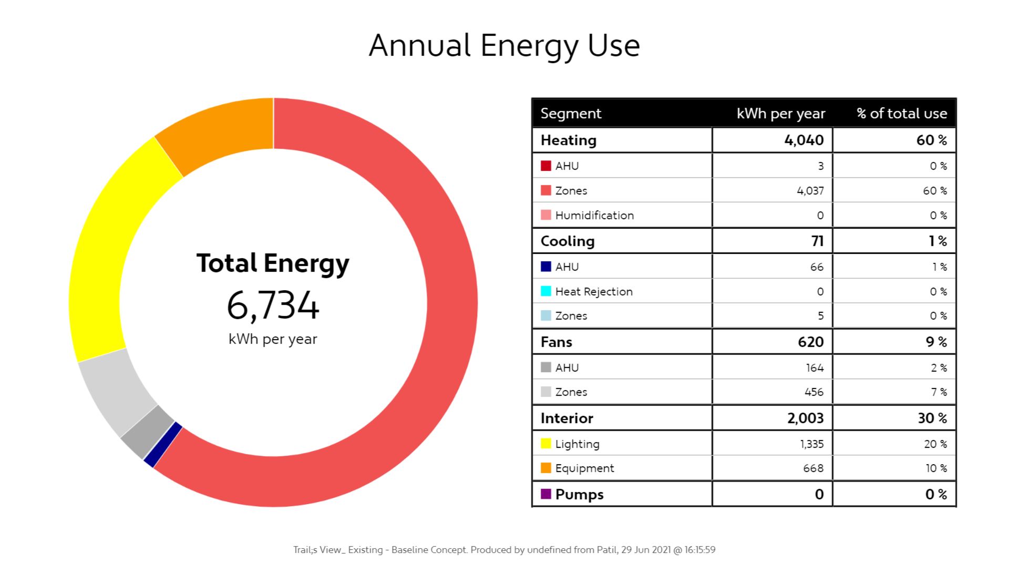
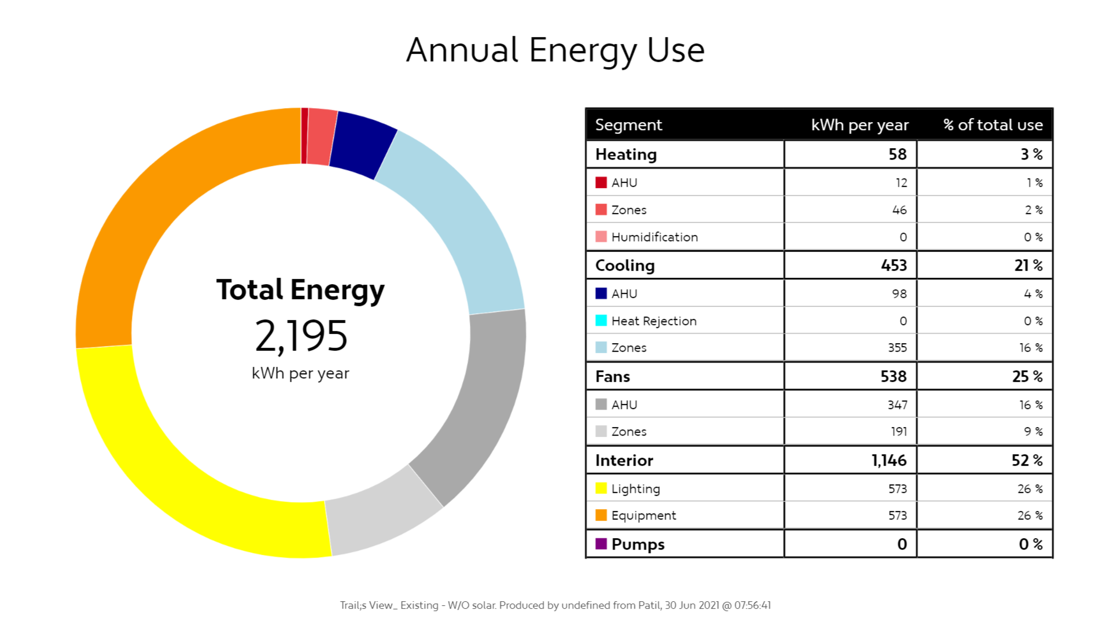
Research Result
Baseline Construction
Net Zero Construction- Without Solar
67%
Reduction in energy consumption without the addition of solar panels
EUI: 38 kBTU/SF/Yr
EUI: 18 kBTU/SF/Yr

Slide 22
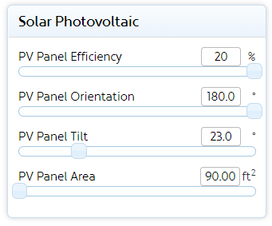
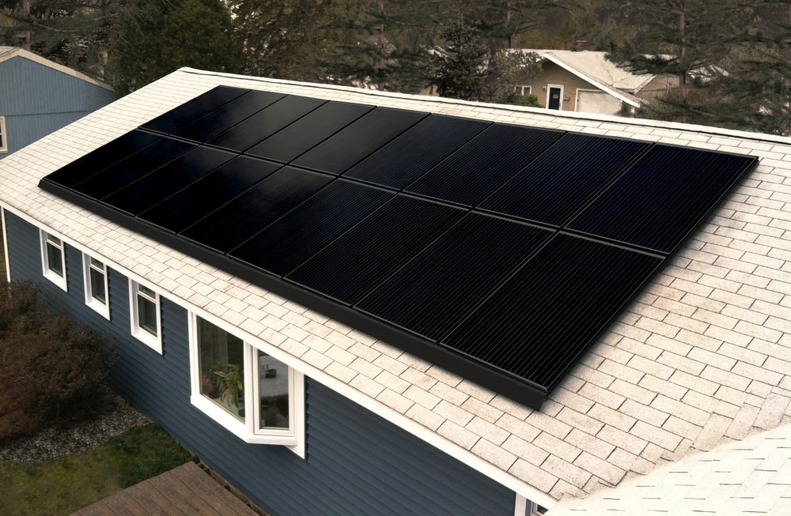
Solar Energy
Zero Energy Building envelopes are extremely energy efficient, but the residual electrical demand must be provided by renewable energy sources such as solar and wind to make the building truly Net-Zero.
100%
Note: Number of solar panels is dependent on the size and the capacity of each panel
Our Considerations for site demand of 2,196 kWh per year:
Size: 5’ X 3’= 15 SF each
Capacity: 280 Watts
Renewable Energy generation on site: 2,269 kWh per year
number of panels: 6 panels
100% reduction of usage of non renewable energy by adding solar panels
Source: Vivint Solar, Unsplash.com

Slide 23
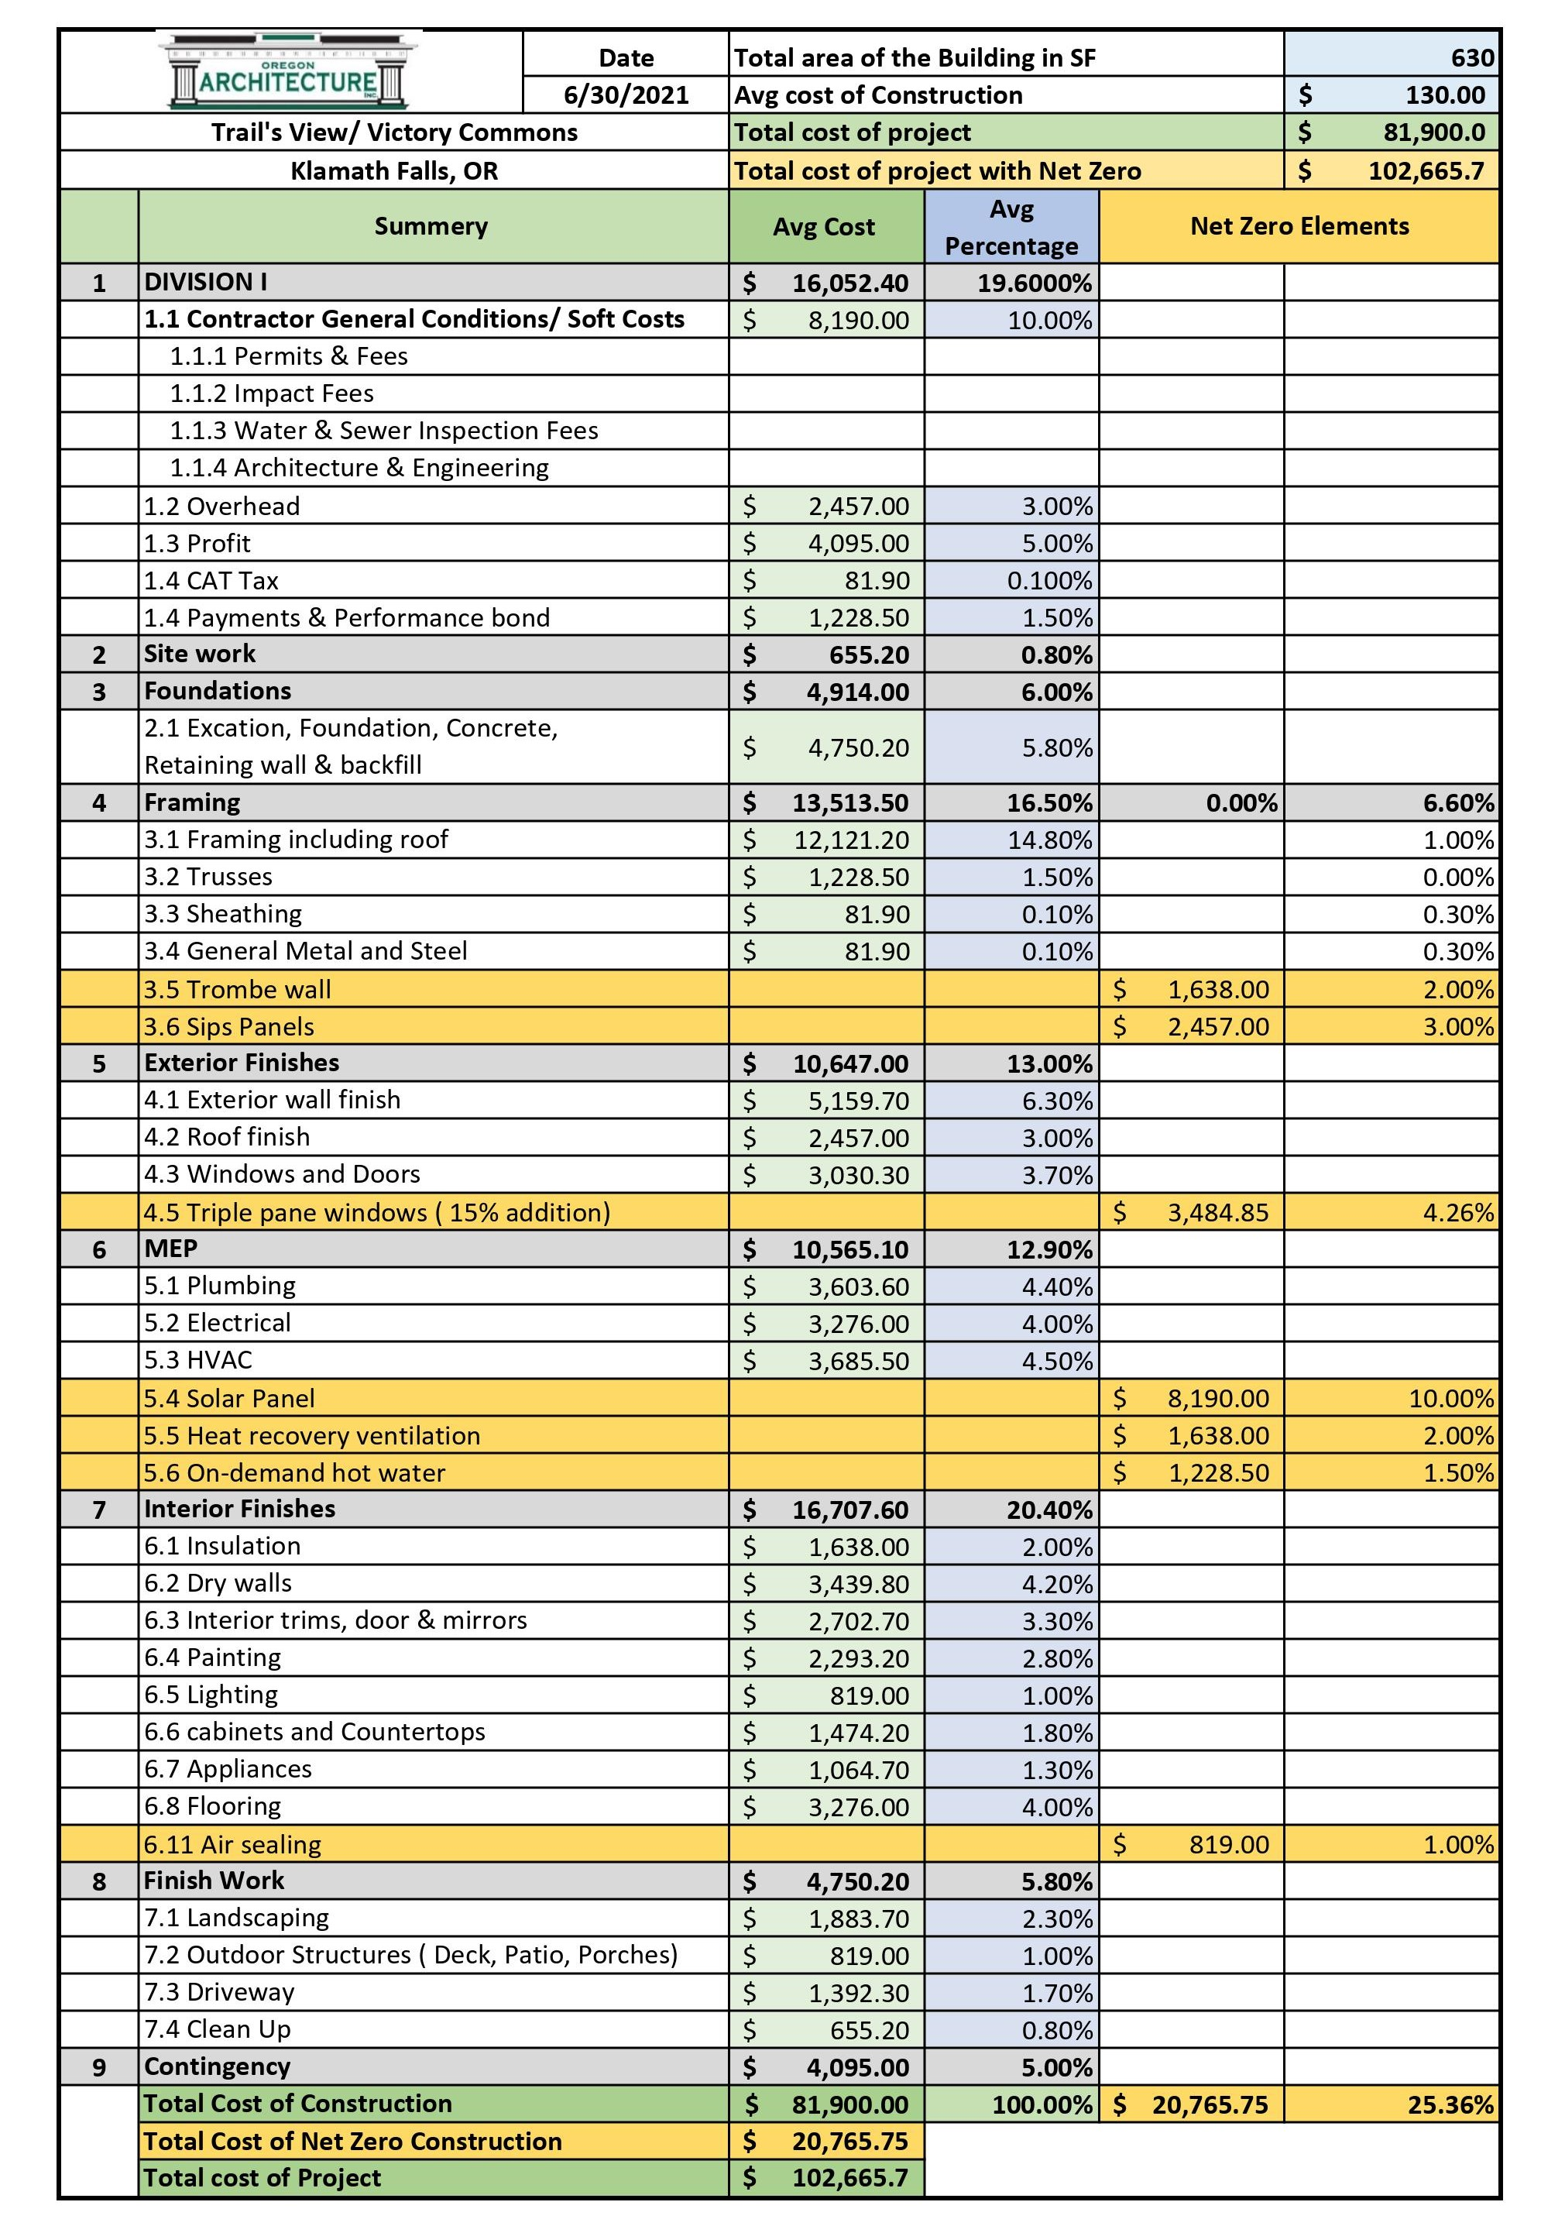
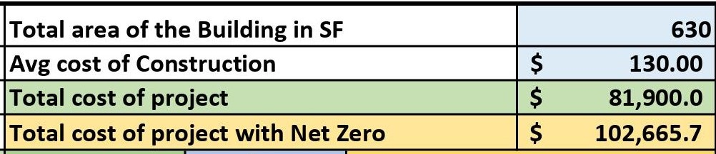
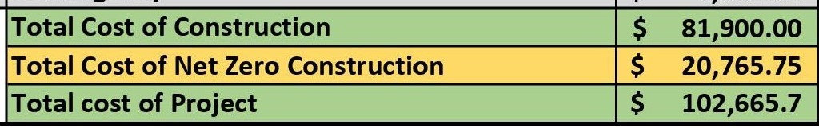
Cost Estimation Tool
Properties Timespan | Victory Commons 1 BR Unit | Victory Commons 2 BR Unit | Trail’s View 1 BR Unit
Avg. Per Month | $52.65 | $90.05 | $78.91
Avg. Per year | $631.77 | $1080.61 | $946.90
10 Years projection | $6,917.71 | $11,503.90 | $10,368.30
20 years projection | $15,350.35 | $25,527.00 | $23,007.18
30 years projection | $26,774.00 | $44,524.30 | $40,129.00
Total cost of Net Zero construction payback in less than 30 years

Slide 24
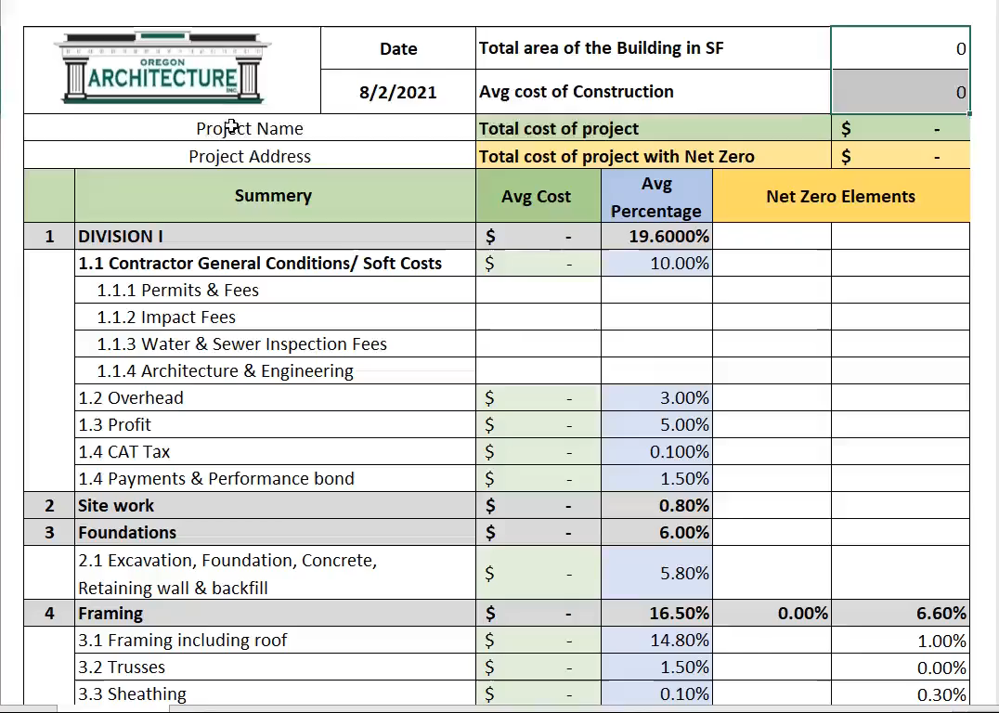
Cost Estimation Tool Sample

Slide 25
Conclusions & Lessons Learned
We discovered quickly from this exercise that creating a zero energy or near-zero energy building shell is possible
with the technology currently available in the marketplace and within a generally reasonable cost.
However, achieving total zero energy is a bit trickier: we will still need a way to electrically power artificial lighting,
refrigeration, cooking, and electrically powered equipment. These tools of modern living are getting more efficient
all the time, but no matter how efficient they become, they will still need electric power. At the moment, the only
option to provide that energy is through the use of solar panels.
Our study shows it is possible to trade the purchase of energy over time to the purchase materials to make a
dwelling more energy efficient initially. Our interactive cost tool provides a way that allows a person to evaluate the
construction cost of an energy upgrade against the potential amount of energy saved in dollars.

Slide 26
That concludes the Presentation.
Thank you.
Are there any questions?

